Slide 1
CS422 Database systems
Data Wrangling
Data-Intensive Applications and Systems (DIAS) Laboratory École Polytechnique Fédérale de Lausanne
Some slides adapted from:
Joe Hellerstein
Xu Chu, Ihab Ilyas
N. Koudas, S. Sarawagi, D. Srivastava

Slide 2
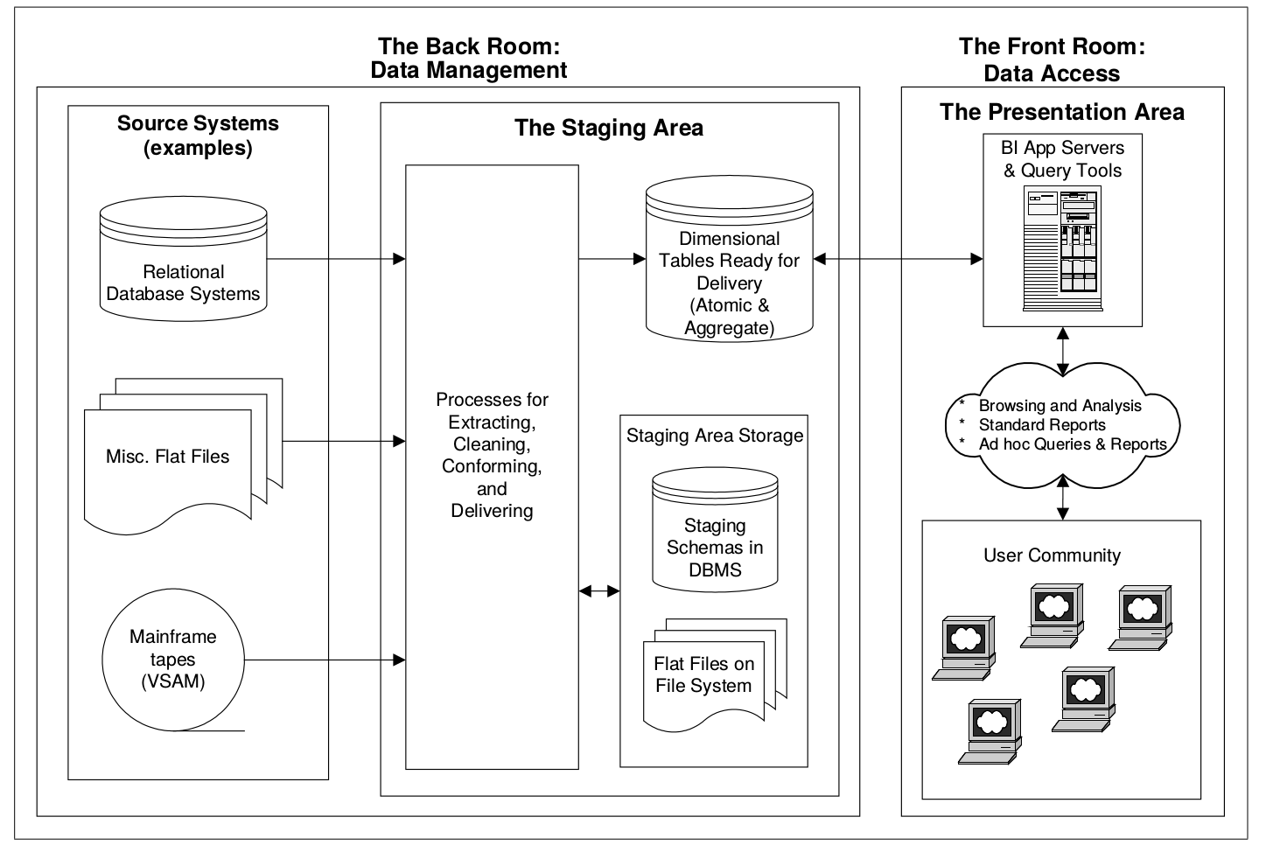
The ETL process
Notes:
The Extract-Transform-Load (ETL) system is the foundation of the data warehouse.
A properly designed ETL system extracts data from the source systems, enforces data quality and consistency standards, conforms data so that separate sources can be used together, and finally delivers data in a presentation-ready format so that application developers can build
applications and end users can make decisions.
- extracting the data from source systems (SAP, ERP, other oprational systems), data from different source systems is converted into one consolidated data warehouse format which is ready for transformation processing.
- transforming the data may involve the following tasks:
applying business rules (so-called derivations, e.g., calculating new measures and dimensions),
cleaning (e.g., mapping NULL to 0 or "Male" to "M" and "Female" to "F" etc.),
filtering (e.g., selecting only certain columns to load),
splitting a column into multiple columns and vice versa,
joining together data from multiple sources (e.g., lookup, merge),
transposing rows and columns,
applying any kind of simple or complex data validation (e.g., if the first 3 columns in a row are empty then reject the row from processing)
- loading the data into a data warehouse or data repository other reporting applications

Slide 3
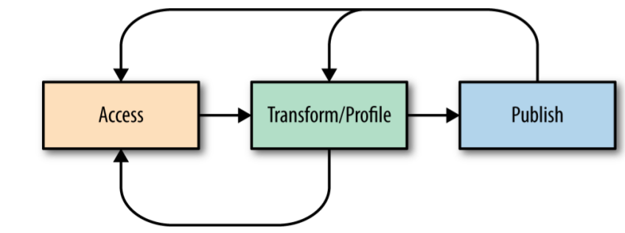
What is data wrangling
Transforming or preparing data for analysis
This is how you “get your head in the game”
Understand what you have
Assess strengths and weaknesses of your data
Hypothesize about what to do with your data
Get it ready
Notes:
Fundamentally, data wrangling is the process involved in transforming or preparing data for analysis.
Data wrangling is the set of actions that allows you to move from raw data to refined data, or from refined data to optimized, production data.
We see data wrangling as a core task within every action in the workflow framework. This is not to say, however, that data wrangling tasks will be identical throughout this workflow
framework. These wrangling tasks will differ, particularly in the kinds of transformations that are applied.
Data wrangling begins with accessing your data. Access also involves manipulating the locations
and relationships between datasets. This kind of data wrangling involves everything
from moving datasets around a folder hierarchy, to replicating datasets across warehouses for easier access, to analyzing differences between similar datasets and assessing overlaps and conflicts.
After you have successfully accessed your data, the bulk of your data wrangling work will involve transforming the data itself—manipulating the structure, granularity, accuracy, temporality, and scope of your data to better align with your analysis goals.
All of these transformations are best performed with tools that provide meaningful feedback (so that the manipulator is assured that the manipulations were successful).
We refer to this feedback as profiling. In many cases, a predefined (and, hence, somewhat generic) set of profiling feedback is sufficient to determine whether an applied
transformation was successful. In other cases, customized profiling is required to make this determination. In either event, the bulk of data wrangling involves frequent iterations between transforming and profiling your data.
A final set of data wrangling tasks can be understood as publishing. Publishing is best understood from the perspective of what is published. In some cases, what is published is a transformed version of the input datasets (e.g., in the design and creation of “refined” datasets).
In other cases, the published entity is the transformation logic itself (e.g., as a script that generates the range of statistics and insights in a regular report). A final kind of publishing involves creating profiling metadata about the dataset. These profiling reports are critical for managing automated data services and products.

Slide 4
ETL vs Data wrangling
ETL
Data wrangling
IT employees build pipelines for their business counterparts
Well-structured data
Data-warehousing applications
Business analysts who know the data
Diverse, complex data
Exploratory analysis use-cases
Different users, different data, different use-cases
Notes:
ETL can be considered to be as one type of data wrangling, specifically a type of data wrangling managed and overseen by an organization’s shared services or IT organization. But data wrangling can also be handled by business users in desktop tools like Excel, or by data scientists in coding languages like Python or R.
Users: The core idea of data wrangling technologies is that the people who know the data best should be exploring and preparing that data. This means business analysts, line-of-business users, and managers (among others) are the intended users of data wrangling tools. I can personally attest to the painstaking amount of design and engineering effort that has gone into developing a product that enables business people to intuitively do this work themselves.
In comparison, ETL technologies are focused on IT as the end users. IT employees receive requirements from their business counterparts and implement pipelines or workflows using ETL tools to deliver the desired data to the systems in the required formats.
Data: Much of the data business analysts must deal with today comes in a growing variety of shapes and sizes that are either too big or too complex to work with in traditional self-service tools such as Excel. Data wrangling solutions are specifically designed and architected to handle diverse, complex data at any scale.
ETL is designed to handle data that is generally well-structured, often originating from a variety of operational systems or databases the organization wants to report against. Large-scale data or complex raw sources that require substantial extraction and derivation to structure are not one of ETL tools’ strengths.
Applications: The use cases we see among users of data wrangling solutions tend to be more exploratory in nature. Users of data wrangling technologies typically are trying to work with a new data source or new combination of data sources for an analytics initiative. We also see data wrangling solutions making existing analytics processes more efficient and accurate as users can always have their eyes on their data as they prepare it.
ETL primarily focuses on extracting, transforming, and loading data into a centralized enterprise data warehouse for reporting and analysis via business intelligence applications.

Slide 5
Stages of Wrangling
Ingest Data
Design & refine data
Optimize data
Raw: Data ingestion & discovery (“unboxing”)
What: Exploratory ad hoc analysis
Who: The individual wrangler
Refined: Curating data for reuse
What: Data warehousing, canonical models
Who: Data curators, IT engineers
Production: Ensuring feeds and workflows
What: Recurrent, automated use cases
Who: SW engineers and IT/ops folks
Generic Metadata
Proprietary Metadata
Ad-hoc reports
Models & predictions
Regular
reports
Products & services
Raw stage
Refined stage
Production stage
Notes:
Data moves through stages, from raw to refined to production. Each stage has a small set of primary actions.
The actions come in two types: in the top three boxes are actions whose results are the data itself, and in the bottom six boxes are actions whose results are derived from or built on top of the data inferences (e.g., insights, reports, products, or services).
Raw stage: the ingestion process involves some initial data transformation operations. These transformations are primarily aimed at mapping inbound elements to those elements’ standard representations in the data warehouse. For example, you might be ingesting a comma-separated values (CSV) file and
need each field in that file to correspond to a particular column in a relational data warehouse. After it is transformed to match the syntax rules defined by the warehouse, the data is stored in predefined locations. Often this involves appending newly arrived data to related prior data. In some cases, appends
can be simple, literally just adding new records at the “end” of the dataset. In other cases, when the incoming data contains edits to prior data as well as new data, the append operation becomes more complicated. These scenarios often require you to ingest new data into a separate location, where more
complex merging rules can be applied during the refined data stage.
Some modern NoSQL databases like MongoDB or Cassandra support less-rigid syntax constraints on incoming data while still supporting many of the classic data access controls of more traditional warehouses. Further along the spectrum (toward relaxed constraints on incoming data) are basic storage
infrastructures like HDFS and Amazon S3 buckets. For most users, S3 and HDFS look and act like regular filesystems. There are folders and files. You can add to, modify, and move them around. And, if necessary, you can control access on a per-file, per-user basis.
The primary benefit of modern distributed filesystems like HDFS and S3 is that data ingestion can be as simple as copying files or storing a stream of data into one or more files. In this environment, the work to make this data usable and accessible is
often deferred until the data is transformed and moved to the refined data stage. This style of data ingestion is often referred to as schema-on-read. In schema-on-read ingestion, you do not need to construct or enforce a usable data structure until you
need to use the data. Traditional data warehouses, in contrast, require schema-on-write, in which the data must adhere to certain structural and syntactic constraints in order to be ingested.
In other words, the two ends of the ingestion complexity spectrum differ based on when the initial enforcement of data structure happens. However, it is important to note that along this entire spectrum of ingestion infrastructures, you will still require
a separate refined data stage. This is because refined data has been further wrangled to align with foreseeable analyses.
Metadata: In most cases, the data that you are ingesting during the raw data stage is known; that is, you know what you are going to get and how to work with it. But what happens when your organization adds a new data source? In other words, what do you do
when your data is partially or completely unknown? Ingesting unknown data triggers two additional actions, both related to the creation of metadata. One action is focused on understanding the characteristics of your data, or describing your data. We refer to this
action as generating generic metadata. A second action is focused on using the characteristics of your data to make a determination about your data’s value. This action involves creating custom metadata.
Design and refine data: After you have ingested your raw data and fully understood the metadata aspects of your raw data, the next major stage in data projects involves refining the data and conducting a broad set of exploratory analyses.
The act of designing and preparing “refined” data often involves a significant amount of transformation. These transformations are often guided by the range of analyses that you plan to conduct on the data, and by the metadata-generating activities
undertaken during the raw data stage. If you previously identified quality and consistency issues with the dataset’s structure, granularity, accuracy, time, or scope, those issues should be remedied during the refined data stage.
Ad-hoc analysis reports: There are many types of ad hoc analyses, ranging from straightforward questions that can be answered in a succinct and definitive manner (e.g., how many customers purchased item X last week, or, what were the top three most viewed documents/pages
on our website last month?) to open-ended investigations that might last months or years (e.g., identify the key factors driving the customer trend of switching from desktop to mobile devices)
Models and predictions: modeling and forecasting analyses are primarily concerned with the future. These analyses ask, “What do we expect to happen given what we have observed in the past?” In the case of forecasting, the explicit objective is to predict future events:
total sales in the next quarter, percent of customer churn next month, likelihoods of each customer renewing their contracts, and so on. In many cases, these predictions are built on models of how the target prediction depends on and relates to other measurable aspects in your dataset. For
some analyses, the useful output is not a prediction (or set of predictions), but the underlying model itself.
Optimize data: You can think of optimized data as the ideal form of your data; it is designed to simplify any additional downstream work to use the data. Unlike refined data, however, the intended use of optimized data should be highly specified.
Regular reports: Regular reports involve monitoring the flow of data and ensuring that requisite structural, temporal, scoping, and accuracy constraints remain satisfied over time. The fact that data is flowing in these systems implies that new (or updated) data will be processed in an ongoing manner.
Structural, temporal, scoping, and accuracy constraints define the boundary around permissible variation (e.g., minimum and maximum sales amounts or coordination between record fields like billing address and currency of transaction).
Product and services: Within the constraints, the reporting and product/service logic must handle the variation. This deviates from exploratory analytics that can, for speed or simplicity, use logic specific to the dataset being analyzed. For production reporting and products/services,
the logic must be generalized. Common dataset variations that drive changes to the data wrangling logic include extensions to the value ranges (e.g., current dates or redefining regions or customer segments); new accuracy issues (e.g., previously unseen misspellings); record fields
that have been removed or emptied (e.g., for legal compliance purposes, certain information about customers like age or gender might be redacted); appearance of duplicate records; or disappearance of a subset of records (e.g., due to a change in customer segment names, one or more groups might be dropped).

Slide 6
Rough Guide to Wrangling Issues
Structure: the “shape” and granularity of a data file
Faithfulness: how well does data capture “reality”
Temporality: how is the data situated in time
Scope: how (in)complete is the data
Notes:
The structure of a dataset refers to the format and encoding of its records and fields. We can consider datasets on a spectrum related to the homogeneity of their records and fields. At one end of the spectrum, the dataset is “rectangular” and can be formatted as a table
with a fixed number of rows and columns. In this format, rows in the table correspond to records, and columns correspond to fields.
If the record fields in a dataset are not consistent (some records have additional fields, others are missing fields, etc.), you could be dealing with a “jagged” table. Such a table is no longer perfectly rectangular. Data formats like JSON and XML support datasets like this, in which record fields are not fully consistent.
The faithfulness of a dataset refers to its quality. In other words, the values populating record fields in the dataset should be consistent and accurate. Common inaccuracies are misspellings of categorical variables, like street or
company names; lack of appropriate categories, like ethnicity labels for multiethnic people; underflow and overflow of numerical values; and missing field components, like a timestamp encoded in a 12-hour format but missing an AM/PM indication.
Temporality: A data record is a representation of an entity at a particular time (or set of times).
Accordingly, even though a dataset might have been an accurate and consistent representation at the time it was created, subsequent changes might render the representation inaccurate or inconsistent.

Slide 7
Outline
Data structuring
Data accuracy
Integrity constraints
Outliers
Duplicates
Temporality

Slide 8
Structuring data
Intrarecord structuring
Reorder record fields (moving columns)
Creating new record fields through extracting values
Combining multiple record fields into a single record field
Interrecord structuring
Filter dataset by removing records
Shift granularity through aggregation and pivots
Notes:
Structuring as a transformation action involves changing your dataset’s structure or granularity.
The first group of structuring transformations involves manipulating individual records and fields. We call this intrarecord structuring. Intrarecord structuring transformations roughly fall into three buckets: …
The second group of structuring transformations involves operating on multiple
records and fields at once. We call this interrecord structuring. These types of transformations fit roughly into two types: …

Slide 9
Intrarecord structuring
Date
03102015
03302015
03022015
Day
10
30
02
Positional extraction
Pattern extraction
Complex structure extraction
JSON array: [“Sally”,“Bob”,“Alon”,“Georgia”]
JSON map: {“product”:“Trifacta Wrangler”, “price”:“free”}
Contribution
P/R DEDUCTION ($296.67 MONTHLY)
P/R DEDUCTION ($326.67 MONTHLY)
Monthly Contribution
$296.67
$326.67
Notes:
Positional extraction: The simplest form of substring extraction works by specifying the starting position and ending position that correspond to the substring that you want to extract from a set of record fields – useful for dates.
Pattern extraction: uses rules to describe the sequence of characters that you want to extract.

Slide 10
Interrecord structuring - Aggregations
contribution data from the US
presidential election
Id | Contribution
C00406 | 750
C00406 | 1000
C00253 | 225
C00253 | 50
Compute:
average contribution
sum of contributions
the number of contributions
Id | Sum Contribution | Mean Contribution | Count Contribution
C00406 | 1750 | 875 | 2
C00253 | 275 | 137.5 | 2
Notes:
Aggregations and pivots are structuring operations that enable a shift in the granularity of a dataset.
In this example, we can perform a basic aggregation on the Individual Contributions dataset. Perhaps we want to manipulate the granularity of the dataset so that each row summarizes the campaign contributions made to each campaign committee.
We are interested in creating three new columns:
• One column that contains the average contribution made to each campaign
committee
• One column that contains the sum of contributions made to each campaign
committee
• One column that counts the number of contributions made to each campaign
committee

Slide 11
Interrecord structuring - Pivots
Unpivoting, denormalization
Region | 2015 | 2016
East | 2300 | 2453
West | 9866 | 8822
Midwest | 2541 | 2575
Restructure data
Each row contains sales for a unique combination of region year
Region | Year | Sales
East | 2015 | 2300
East | 2016 | 2453
West | 2015 | 9866
West | 2016 | 8822
Midwest | 2015 | 2541
Midwest | 2016 | 2575
Notes:
This type of column-to-row pivot is commonly referred to as “unpivoting” or “denormalizing” data. It is particularly useful when your source data contains multiple columns that represent the same type of data.
For example, you may have a transactions file that contains the total sales numbers per region, per year.
We want to restructure this dataset so that a single row contains the sales for
a single unique combination of region and year.

Slide 12
Outline
Data structuring
Data accuracy
Integrity constraints
Outliers
Duplicates
Temporality

Slide 13
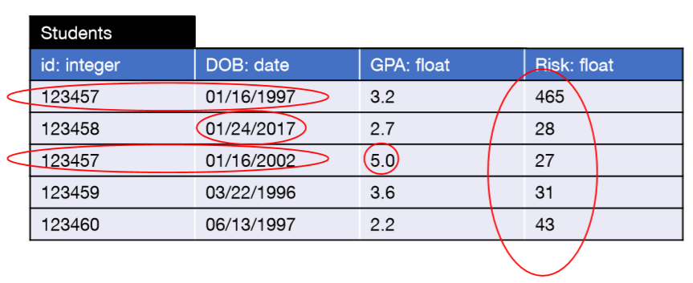
Assessing faithfulness
The faithfulness of a record can only be evaluated in context
Application context
Context in your data set
Across records
Notes:
The third type of data transformation cleans a dataset to fix quality and consistency issues.
A dataset might contain multiple erroneous fields or records which can be detected and fixed based on the context.
In this example we have the same student appearing with two different dates of birth, we might have invalid dates, a GPA outside the acceptable range, and outlier values (risk)

Slide 14
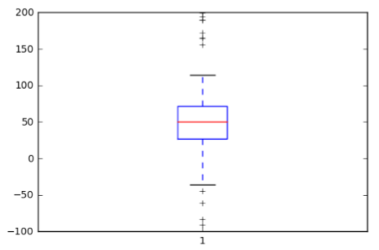
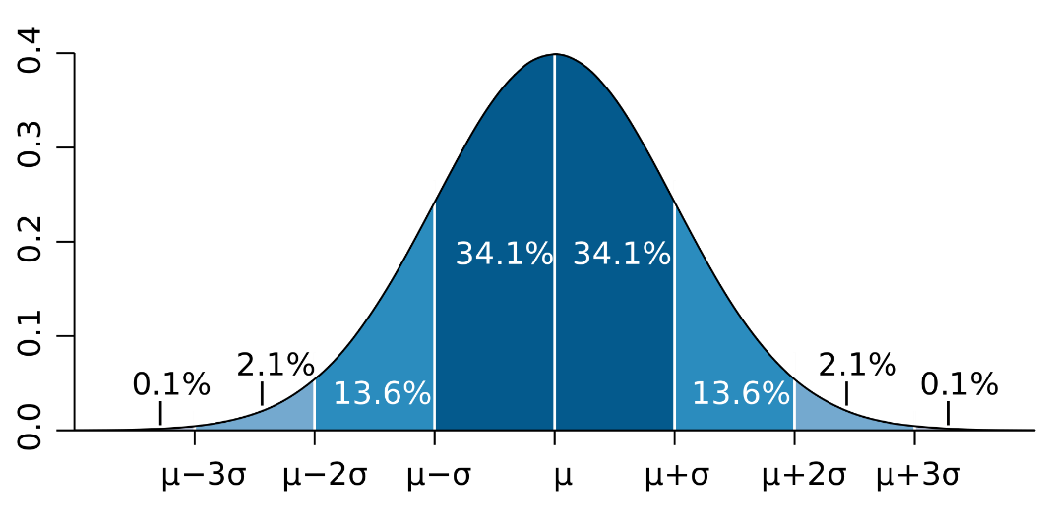
Faithfulness across records: Outliers
What is an “outlier”?
A value that is “far” from the “center”
Distribution-based definition
Center (e.g. average, median)
Spread (e.g. standard deviation, IQR)
source: wikipedia
Notes:
One common type of inconsistency is the existence of outlier values. An outlier is a value that is far from the center (e.g., average). An outlier may be due to variability in the measurement or it may indicate experimental error. Outliers cause serious errors in statistical analysis.
In general, if the nature of the population distribution is known a priori, it is possible to test if the number of outliers deviate significantly from what can be expected.
In normal distributions for example, The three sigma rule means that roughly 4.4% of the observation observations will differ by twice the standard deviation or more from the mean, and 0.2% will deviate by three times the standard deviation. Therefore, if there are more, then they are a reason to concern.

Slide 15
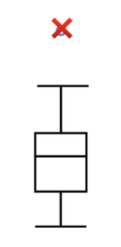
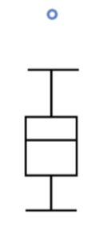
What to do with outliers?
Delete (“trimming”)
Set to a default
E.g., the nearest non-outlier
Good Hygiene:
Leave the original column
Derive an indicator column to flag presence of outlier
Derive a clean column for your use
Notes:
There are several approaches to deal with outliers. The most common approach involves deleting the outlier values.
Another approach maps outliers to a default value, e.g., the nearest non-outlier or the average, median value.
However, in order to avoid introducing extra errors to the dataset a good approach is to flag the outlier values and introduce a new clean column which will be used for the analysis.

Slide 16
Correlations within records
Dependence (i.e. lack of independence!) between 2 random variables
Think of the attributes in a relational schema
An instance of that relation was generated from some real-world process
Each column of that relation is a “random variable” generated by the process
A Functional Dependency is a “deterministic” correlation
Notes:
Another type of violation that might exist involves violation of a certain property that might hold between the attributes of the dataset.
In general attributes of a database might depend on each other. Correlations between attributes are important for schema matching or query optimization.
If we assume that the dataset gets generated from a real-world process, and the attributes are random variables generated by the process, then there might happen that the random variables might depend on each other.
A common correlation that might occur is the functional dependency, which denotes a deterministic correlation between attributres.

Slide 17
Functional Dependencies (FDs)
Generalization of Keys
Attribute A determines Attribute B
customerId -> age
i.e. age= f(customerId)
A set of columns determines another set of columns
transactionTime, customerId -> age, residenceArea
Primary Keys are special FDs
Right-hand-size is the set of all attributes in the relation
Notes:
A functional dependency is a constraint between two sets of attributes in a relation from a database. In other words, functional dependency is a constraint that describes the relationship between attributes in a relation.
It is a generalization of keys. The existence of a key denotes a functional dependency among the key attribute of the database and the rest attributes of the tuple.
For example, ..

Slide 18
Conditional Functional Dependencies
(X → Y, Tp)
An FD defined on a subset of the data
Example: ZIP → Street is valid on subset of the data where Country = “England”
Example: AC = 020 where City = London
Notes:
A more expressive type of constraint which can capture real-life cases that FDs cannot, is the case of CFDs.
CFDs are an extension of FDs, are capable of capturing FDs that hold partially on the data.
Therefore, the dependency X->Y holds over a subset of the data defined by Tp.
Tp is called a pattern tableau of the FD, where for every attribute A ∈ X ∪ Y and each pattern tuple t p ∈ T p , either t p [A] is a constant
in the domain Dom(A) of A, or t p [A] is a wild card ‘-’.

Slide 19
CFD example
({name, type, country} → {price, tax}, Tp)
TID | Name | Type | Country | price | tax
t1 | Harry Potter | book | France | 10 | 0
t2 | Harry Potter | book | France | 10 | 0
t3 | Harry Potter | book | France | 10 | 0.05
t4 | Terminator | DVD | Italy | 25 | 0.08
t5 | Terminator | DVD | Italy | 25 | 0.05
t6 | Spiderman | DVD | UK | 19 | 0
Name | Type | Country | price | tax
- | book | France | - | -
- | - | UK | - | -
CFD needs to hold only over the tuples matching the tableau
Notes:
The FD does not hold on the entire relation (e.g., t4 and t5 are not violating the CFD) but it holds if the type is book or the country is UK

Slide 20
Matching Dependencies
Tran:
MD: Tran[LN, City, Street, Post] = card[LN, City, St, Zip] ^
Tran[FN] ≈ Card[FN] → Tran[FN, Phone] ↔ Card[FN, Tel]
FN | LN | Street | City | AC | Post | Phone | Item
Robert | Brady | 5 Wren St | London | 020 | WC1H | 3887834 | Watch
Robert | Brady | Null | London | 020 | WC1H | 3887834 | necklace
Master: Card
FN | LN | Street | City | AC | Zip | Tel
Robert | Brady | 5 Wren St | London | 020 | WC1H | 3887644
Notes:
Matching dependencies (MDs) use similarity measures to generalize the equality condition used in FDs, to support record linkage across two tables.
While FDs are defined on a single relation, MDs are defined on two relations.
A matching dependency φ for two relations (R1, R2 ) is defined as follows:
∧ j∈[1,k] (R1[X1[j]] ≈ R2[X2[j]]) → R1[Z1] ↔ R2[Z2]
Intuitively, an MD φ states that if R1[X1] and R2[X2] are similar with respect to some similarity metrics, then R1[Z1] and R2[Z2] should be changed to be identical.

Slide 21
More complex integrity constraints
Employees
ID | FN | LN | Role | City | State | Salary
105 | Anne | Nash | M | NYC | NY | 110
211 | Mark | White | E | SJ | CA | 80
386 | Mark | Lee | E | NYC | AZ | 75
235 | John | Smith | M | NYC | NY | 1200
Functional Dependency: City → State
Business Rule:
Two employees of the same role, the one who lives in NYC
cannot earn less than the one who does not live in NYC
Notes:
There might exist more complex integrity constraints that can capture arbitrary rules that the user needs to apply in order to detect more complex inconsistencies.
However, the more expressive an IC language is, the more difficult it is to exploit it in automated data cleaning algorithms, or even in consistency checking.
For example, suppose the following dataset, and the FD: City -> State. Suppose that an analyst wants to discover violations of the following business rule…
Then this rule cannot be covered by the existing FD.

Slide 22
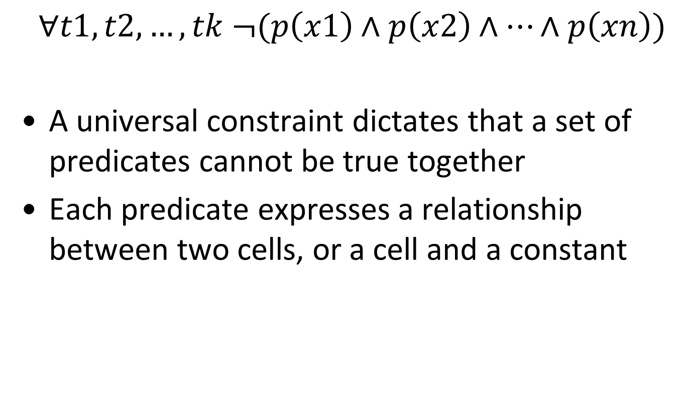
Denial Constraints (DCs)
$$∀t1, t2, …, tk ¬(p\left(x1\right)∧p\left(x2\right)∧…∧p\left(xn\right))$$
A universal constraint dictates that a set of predicates cannot be true together
Each predicate expresses a relationship between two cells, or a cell and a constant
FDs and CFDs are subcategories of DCs
Notes:
Denial constraints (DCs), a universally quantified first order logic formalism, which subsume FDs and CFDs, can describe all aforementioned data quality rules.
The definition of DCs is that given any combination of tuples t1, t2,… the predicates p(xi) cannot be all true at the same time, otherwise we have a violation.

Slide 23
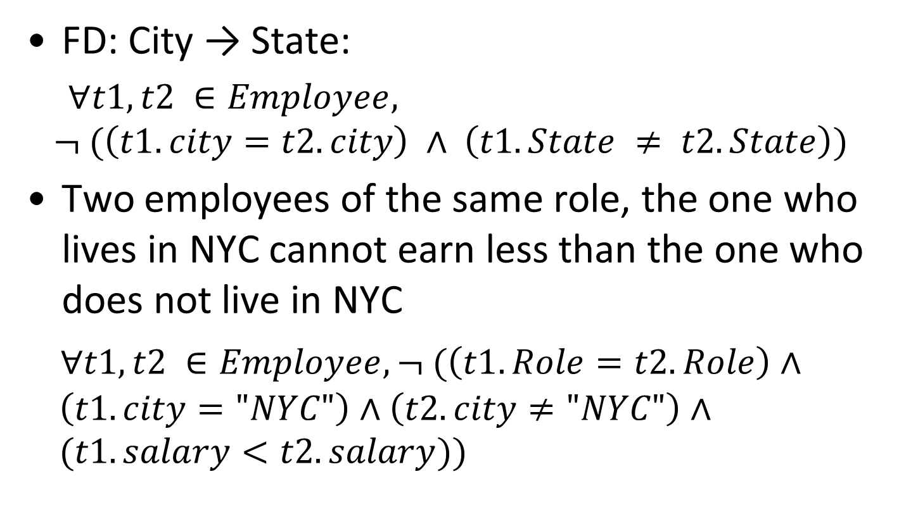
Denial Constraints: Example
FD: City → State:
$∀t1, t2 ∈Employee,$
$$¬ (\left(t1.city=t2.city\right) ∧ \left(t1.State ≠ t2.State\right))$$
Two employees of the same role, the one who lives in NYC cannot earn less than the one who does not live in NYC
$∀t1, t2 ∈Employee,¬ (\left(t1.Role=t2.Role\right)∧ \left(t1.city="NYC"\right)∧\left(t2.city≠"NYC"\right)∧ (t1.salary<t2.salary))$
DCs are expressive enough to support
arbitrary data quality rules
Notes:
The first example shows how we can express a functional dependency using the syntax of DCs. At a high level, an FD of the form city -> state can be represented as that there are no two tuples that have the same city name and different state value.
DCs are expressive enough to support the data quality rule of the previous example which states that an employee who lives in NY cannot earn less than one that does not.

Slide 24
Data Deduplication
Similarity measures
Machine learning for classifying pairs as duplicates or not (unsupervised, supervised, and active)
Clustering and handling of transitivity
Merging and consolidation of records
Notes:
Data deduplication is the process of identifying tuples in one or more relations that refer to the same real world entity.
To determine whether two tuples are identical we need similarity measures, which are used to compute the similarity between the tuples.
Based on the similarity metrics there are multiple approaches that can be used to detect and eliminate duplicates. There are supervised, unsupervised and active learning approaches that classify tuples as duplicates or not.
A commonly used approach is the unsupervised one, which uses clustering methods to group similar entities together, and also exploits the transitivity property to incrementally enhance the clusters with all the similar tuples
that exist in the cluster.
Finally, given that the clusters contain duplicate values, duplicate elimination approaches need to find the representatives of each cluster which correspond to the canonical value of the cluster.

Slide 25
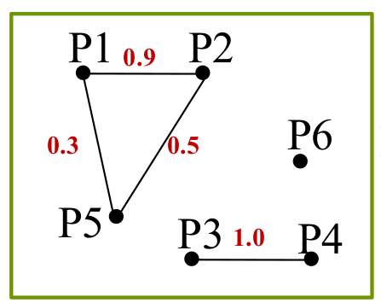
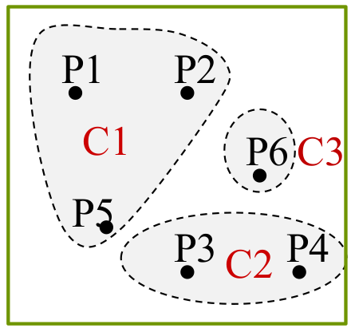
Duplicate elimination with clustering
Unclean relation
Compute
pair-wise
similarity
ID | Name | ZIP | Income
P1 | Green | 51519 | 30K
P2 | Green | 51518 | 32K
P3 | Peter | 30528 | 40K
P4 | Peter | 30528 | 40K
P5 | Gree | 51519 | 55K
P6 | Chuck | 51519 | 30K
Clean relation
Merge
clusters
ID | Name | ZIP | Income
C1 | Green | 51519 | 39K
C2 | Peter | 30528 | 40K
C3 | Chuck | 51519 | 30K
Notes:
The result of pairwise comparison process, which takes O(n 2 ) comparisons for a database of n records, can be represented as a graph, where nodes represent records, and edges between nodes exist if they
are considered duplicates by the classifiers. Each edge may also have a weight, reflecting the confidence of the two nodes connected by the edge being duplicates, e.g., the similarity between the two records. The
graph is thus referred to as similarity graph. The goal of clustering is to partition all records into disjoint clusters of records, where each cluster corresponds to one real-world entity, and records in a cluster are
different representations of the same entity.
Another way to obtain such clustering of records is to leverage the transitivity of duplicate records, that is, if Record A is a duplicate of Record B, and Record B is a duplicate of Record C, then Record A
is a duplicate of Record C. Then the clustering problem becomes the problem of finding all connected components in the similarity graph.
Each connected component is one cluster that represents one real-world entity. One major drawback of such approach is that it may mistakenly consider two records as duplicates since they are in the same
connected component, even though they are very dissimilar.

Slide 26
Possible Repairs
A possible repair is a clustering (partitioning) of the input tuples
Possible repairs
ID | Name | ZIP | Income
P1 | Green | 51519 | 30K
P2 | Green | 51518 | 32K
P3 | Peter | 30528 | 40K
P4 | Peter | 30528 | 40K
P5 | Gree | 51519 | 55K
P6 | Chuck | 51519 | 30K
X1
{P1}
{P2}
{P3,P4}
{P5}
{P6}
X2
{P1,P2}
{P3,P4}
{P5}
{P6}
X3
{P1,P2,P5}
{P3,P4}
{P6}
Notes:
Providing a single solution to the deduplication problem might result in inaccurate fixes since there might be multiple different output clustering options each of which might produce different representatives.
Therefore to solve this problem duplicate elimination techniques propose multiple uncertain repairs and then the user can decide on the correct one.
The different repairs result by having different configurations for the clustering algorithms, f.eg., by having different similarity thresholds

Slide 27
Temporality
Often two kinds of time in data
Time of data entry
Time of a recorded phenomenon being “true”
E.g. A physical time of an event happening
E.g. An “effective” time, e.g. date that a subscription will start
Often more
Time is tricky!
Periodicities (recurring patterns in Days of the week)
Non-uniform hierarchy of units (# days in a month, # of days in a year, etc.)
Time zones are complex
Clocks can be skewed
Relativity: true perception of event may vary
Notes:
A data record is a representation of an entity at a particular time.
When we talk about temporality, there are two kinds of time.
Accordingly, even though a dataset might have been an accurate and consistent representation at the time it was created, subsequent changes might render the representation inaccurate or inconsistent.
For example, you might use a dataset of customer actions to determine the distribution of items people own. Weeks or months after an initial sale, however, some of these items might be returned. Now the original dataset,
although an accurate representation of the original sales transaction, is no longer an accurate representation of the items a person owns.

Slide 28


Slide 29
Outline
Data repairing techniques
Dealing with similarity comparisons

Slide 30
Data repairing techniques
Repair target
(what to repair?)
Automation
(how to repair?)
Data
Rules
Both
Automatic
Human guided
Trust the
rules
Trust the
Data
Schema evolution
Obsolete rules
Notes:
Given a relational database instance and a set of data quality requirements expressed in a variety of ways, data repairing refers to the process of finding another database instance I 0 that con-
forms to the set of data quality requirements.
Repair Target (What to Repair?) Repairing algorithms make different assumptions about the data and the quality rules:
trusting the declared integrity constraints, and hence, only data can be updated to remove errors,
trusting the data completely and allowing the relaxation of the constraints, for example, to address schema evolution and obsolete business rules,
(3) exploring the possibility of changing both the data and the constraints.
Automation (How to Repair?) We classify proposed approaches with respect to the tools used in the repairing process. More specifically, we classify current repairing approaches according to whether and how humans are involved. Some techniques are
fully automatic, for example, by modifying the database, such that the distance between the original database I and the modified database I 0 is minimized according to some cost function.
Other techniques involve humans in the repairing process either to verify the fixes, to suggest fixes, or to train machine learning models to carry out automatic repairing decisions.

Slide 31
Data repairing automation
Most automatic repairing techniques adopt the “minimality” of repairs principle
Minimal repairs principle: the distance between the original database and the modified database is minimized
Repairing techniques in practice are:
predominantly manual and
semi-automatic at best
Data repairing requires ground
truth to infer the correct value
of an erroneous cell
Notes:
With a lack of ground truth, the main hypothesis behind the minimality objective function is that a majority of the database is clean, and, thus, only a relatively small number of updates need to be performed compared to the database size.
In practice, most of the time it is impossible to automatically infer the correct value that serves as a replacement for an erroneous value; to accurately update an erroneous cell, there is need for manual work, or for master data (ground truth).
Therefore, the objective for data wrangling is to minimize human effort. The main approach for this, is to propose a set of candidate repairs instead of one, in order to allow the user select one of them.

Slide 32
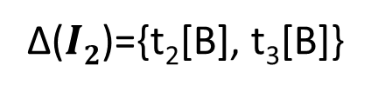

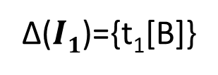



Data repairing FD violations
$I$ is a dirty database if $Ι⊭Σ$ and $Ij$ is a repair for $I$ if $Ij ⊨Σ$
For a repair $Ij$ , Δ($Ij$) is the set of changed cells
$$I$$
$$I1$$
$$I2$$
A | B
1 | 2
1 | 3
1 | 3
4 | 5
A | B
1 | 3
1 | 3
1 | 3
4 | 5
A | B
1 | 2
1 | 2
1 | 2
4 | 5
t₁
t₂
t₃
t₄
Σ= {Α → Β}
Δ($I1$)={t₁[B]}
Δ($I2$)={t₂[B], t₃[B]}
Minimal repair
Notes:
Let’s see an example of data repairing in the case of FD violations.
Given a set Σ of rules, we say that a db I is dirty if the rules do not hold in I, and a repair of the db is an instance in which the rules hold.
In I, the first 3 tuples violate the FD A->B. To fix the violation, we need to update the tuples in a way that the FD is satisfied.
Thus, one approach would be to update the value of B in t1, or update the value of B in t2 and t3. An automatic data repairing system, would output Δ(I1) because it corresponds to the minimal repair of the dataset.

Slide 33
Outline
Data repairing techniques
Dealing with similarity comparisons
Notes:
Repairing violations of integrity constraints is tricky and expensive. However, a more challenging case is the one that corresponds to similarity comparisons. For example in order to detect duplicates, each tuple needs to be compared with every other tuple.
Executing the cartesian product and on top of it applying a similarity comparison is an overkill. Therefore, we will see some approaches that prune the number of similarity comparisons.

Slide 34
Fuzzy join
A fuzzy join of R₁(A₁,...,A_{n}) and R₂(B₁,...,B_{m}) is:
A subset of the cartesian product of R₁ and R₂
“Matching” specified attributes A_{i1}, ..., A_{ik} with B_{i1}, ..., B_{ik}
Labeled with a similarity score > t > 0
Naïve method: for each record pair, compute similarity score
I/O and CPU intensive, not scalable to millions of records
Goal: reduce O(n²) cost to O(n*w), where w << n
Reduce number of pairs on which similarity is computed
Take advantage of efficient relational join methods
Notes:
The task in which we need to perform a join that involves a similarity comparison instead of an equality comparison is called fuzzy join. In the case of a duplicate elimination task this would be a fuzzy self join.
The fuzzy join is defined as follows.

Slide 35
Q-gram set join
Goal: compute thresholded similarity distance join on string attributes
Methodology: domain-independent similarity
Extract set of all overlapping q-grams Q(s) from string s
Dist(s1,s2) ≤ d → |Q(s1) ∩ Q(s2)| ≥ max(|s1|,|s2|) - (d-1)*q – 1
Cheap filters (length, count, position) to prune non-matches
Pure SQL solution: cost-based join methods
Lesson: reduce fuzzy join to
aggregated set intersection
Notes:
One common approach that reduces the number of similarity comparisons is the Q-gram set join. It is based on the q-gram idea in which we split each word into overlapping tokens of size q. Then the similar words will be the ones that have multiple common tokens.
The high level idea of Dist(s1,s2) ≤ d → |Q(s1) ∩ Q(s2)| ≥ max(|s1|,|s2|) - (d-1)*q – 1 is that:
Since a string of length |s| contains |s|+q-1 tokens, and one different letter changes at most q tokens, then we need to have at least max + q – 1 – d*q tokens = max –(d-1)q - 1

Slide 36
Q-gram set join in action
ID | Name
r1 | Srivastava
r2 | Shrivastava
r3 | Shrivastav
ID | Name | 3-grams
r1 | Srivastava | ##s, #sr, sri, riv, iva, vas, ast, sta, tav, ava, va$, a$$
r2 | Shrivastava | ##s, #sh, shr, hri, riv, iva, vas, ast, sta, tav, ava, va$, a$$
r3 | Shrivastav | ##s, #sh, shr, hri, riv, iva, vas, ast, sta, tav, av$, v$$
Edit Distance (ED):
ED(s1,s2) ≤ d → |Q(s1) ∩ Q(s2)| ≥ max(|s1|,|s2|) - (d-1)*q – 1
ED(r1, r2) ≤ 1, |Q(r1) ∩ Q(r2)| = 10
ED(r1, r3) ≤ 1, |Q(r1) ∩ Q(r2)| = 7
Notes:
Suppose that we need to perform the fuzzy self join of a table. We can compute the q-grams with q = 3.
The tokens are overlapping; the output set is computed using a sliding window of size 3.
With red color we can see the tokens that are different between tuples t1-t2 and t1-t3 respectively.
Given d = 2
For ED(r1, r2) >= 11-3 -1 = 7
ED(r1,r3) >= 10-4=6
d=1
11-1=10
10-1=9

Slide 37
Q-gram set join in action
ID | Name
r1 | Srivastava
r2 | Shrivastava
r3 | Shrivastav
Q
ID | Qg
r1 | ##s
r1 | #sr
r1 | sri
r1 | riv
r1 | iva
r1 | vas
r1 | ast
r1 | sta
r1 | tav
r1 | ava
r1 | va$
r1 | a$$
ID | Qg
r3 | ##s
r3 | #sh
r3 | shr
r3 | hri
r3 | riv
r3 | iva
r3 | vas
r3 | ast
r3 | sta
r3 | tav
r3 | av$
r3 | v$$
SELECT Q1.ID, Q2.ID
FROM Q AS Q1, Q AS Q2
WHERE Q1.Qg = Q2.Qg
GROUP BY Q1.ID, Q2.ID
HAVING COUNT(*) > T
Notes:
Thus, based on the preprocessing step of computing the q-grams, to decide on the similar pairs, we need to aggregate the common tokens by grouping based on each pair, and keep the ones that exceed the threshold.

Slide 38
Scaling out similarity joins
ClusterJoin, 2014
Sample anchor points
Assign values to the closest anchors
Take into consideration neighboring partitions
R1 (Anchor)
R3’s outer partition
R2’s outer partition
R1’s outer partition
R3 (Anchor)
R2 (Anchor)
Notes:
Another approach for computing similar entities which can deal with data skew is the clusterjoin approach.
The main benefit of clusterjoin is that it avoids uniform space-partitioning, which is likely to lead to imbalanced partition with skewed data distributions
The approach that it follows is a non-uniform space partitioning based approach by sampling the data
and allowing the sampled set to determine our space partitioning.
By doing so, our partitions capture the underlying data distribution,
and lead to a more balanced partitioning scheme.
Thus in the example we randomly sample 3 points R1, R2, R3, which seve as the three anchor points, and then each candidate word is assigned to the closest anchor; it resembles k-means with one iteration.
The main issue is the fact that one point might be close to more than one partition. Thus, we assign each point to both the closest partition and its neighboring partitions.

Slide 39
Conclusion
Data transformations
Update structure and granularity
Data accuracy
Error detection using rules or similarity comparisons
Data repairing is expensive and requires human guidance

Slide 40
Reading material
I. F. Ilyas and X. Chu. Trends in cleaning relational data: Consistency and deduplication. Foundations and Trends in Databases, 5(4):281–393, 2015
A. D. Sarma, Y. He, and S. Chaudhuri. ClusterJoin: A Similarity Joins Framework using Map-Reduce. PVLDB, 7(12):1059–1070, 2014
T. Rattenbury, J.M. Hellerstein, J. Heer, S. Kandel, and C. Carreras, Principles of Data Wrangling: Practical Techniques for Data Preparation. O'Reilly Media, 2017

